Slide 1
Voice Based Patient Call System
Charulata Jinagouda

Slide 2
Problem Statement
Key Problems Identified:
Delayed Nurse Response: Patients often experience delays in getting assistance due to manual call systems.
Lack of Prioritization: Current systems do not differentiate between urgent and non-urgent requests, resulting in inefficient resource utilization.
Limited Communication Channels: Patients typically rely on a single-button system that lacks clarity and context about their needs.
Inconsistent Monitoring: Administrators have limited visibility into response times and nurse workload, making it harder to track service quality.

Slide 3
Proposed Solution
Core Features of the Solution:
Voice-Based Patient Requests: Patients can initiate requests using natural language through a voice-enabled interface.
AI-Driven Prioritization: An AI engine classifies requests based on urgency (e.g., emergency, assistance, or routine).
Real-Time Mobile Notifications: Nurses receive real-time notifications with detailed information about the patient’s request.
Data-Driven Monitoring: Admin dashboards provide insights into request patterns, response times, and overall performance.

Slide 4
System Workflow
Step-by-Step Workflow:
Patient Request: The patient speaks into the device to make a request (e.g., “I need water” or “I feel pain”).
Speech Recognition: The request is converted from voice to text using Gemini Speech Services.
Natural Language Processing: The system processes the request using NLP to extract intent and context.
Priority Assignment: AI assigns a priority level to the request (Critical, Important, Normal).
Backend Processing: The backend server handles the request, stores it in the database, and sends it to the appropriate nurse.
Real-Time Notification: Nurses receive notifications on their mobile app with request details and priority.
Response and Status Update: The nurse attends to the request and updates the status (Pending, In Progress, Resolved). The update is reflected in real-time across the system.

Slide 5
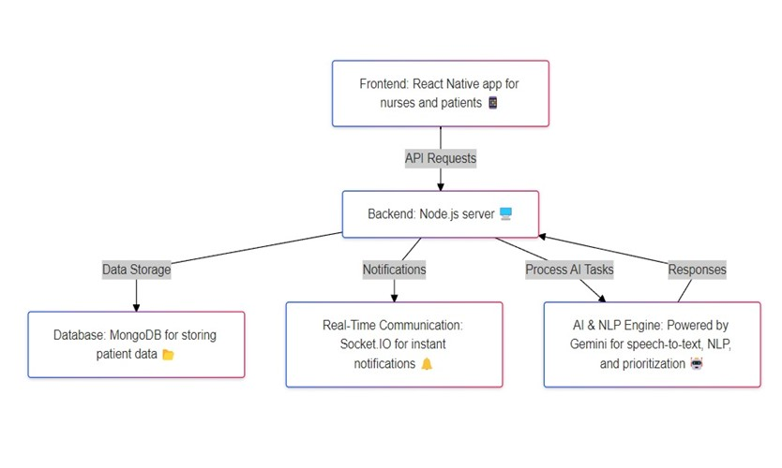
SYSTEM ARCHITECTURE

Slide 6
Key Features
Voice-Based Interface: Patients can use their voice to request assistance, eliminating the need for complex interactions.
AI & NLP-Driven Processing: The AI engine interprets requests and assigns appropriate priority levels.
Role-Based Access Control: Different interfaces and functionalities for patients, nurses, and administrators.
Real-Time Communication: Socket.IO facilitates instant updates, ensuring nurses are always informed about pending requests.
Data Logging and Analytics: All requests and responses are logged, providing valuable insights for performance analysis.

Slide 7
Multi-Role Access Control
Details on Each Role:
Patients:
Can register and log in using simple credentials.
Initiate requests through voice commands.
View the status of their requests (Pending, In Progress, Resolved).
Nurses:
Secure registration with admin approval.
Receive prioritized requests with detailed descriptions.
Update the status of each request as they work on them.
Admins:
Manage users (add, remove, update patients and nurses).
Monitor system activity, including real-time requests and responses.
Generate reports on nurse performance and system usage.

Slide 8
Technology Stack
Backend Technologies:
Node.js: JavaScript runtime for building scalable server-side applications.
Express.js: A web application framework for handling HTTP requests and routing.
MongoDB: A NoSQL database for storing unstructured data, ideal for dynamic healthcare data.
Socket.IO: Enables real-time, bidirectional communication between the server and clients.
JWT (JSON Web Tokens): Ensures secure user authentication and session management.
Frontend Technologies:
React Native: Framework for building cross-platform mobile apps for nurses and patients.
Expo: Provides tools and services for developing, building, and deploying React Native apps.
Socket.IO Client: Connects the mobile app with the server for real-time communication.

Slide 9
AI & NLP Functionality
Gemini NLP Engine:
Uses advanced machine learning models to interpret natural language requests.
Identifies key intent (e.g., request type) and extracts contextual information (e.g., urgency).
Continuously improves accuracy through feedback and training data.
Speech Recognition:
Powered by Gemini Speech Services, which converts patient voice input into structured text.
Supports multiple languages and dialects for diverse patient demographics.

Slide 10
Real-Time Communication
How Real-Time Communication Works:
Instant Notifications: When a patient request is processed, Socket.IO sends a real-time notification to the nurse app.
Live Updates: Nurses can update the status of requests, and these changes are reflected immediately in the patient interface.
Error Handling: The system ensures robust error handling to avoid message loss or delays.

Slide 11
Admin Dashboard
Key Functionalities:
User Management: Admins can manage users, including registering new nurses and patients.
Request Logs: View detailed logs of all requests, including timestamps, priority, and response times.
Analytics and Reports: Generate reports to analyze nurse performance, average response time, and system usage trends.

Slide 12
Nurse Dashboard
Dashboard Features:
Request List: Displays all active requests with priority indicators.
Status Update: Allows nurses to update the status of requests (Pending, In Progress, Resolved).
History View: Nurses can view past requests and their statuses for reference.

Slide 13
Installation Steps
Clone the repository from GitHub.
Install dependencies using npm install.
Configure the .env file with MongoDB URI and JWT secret.
Start the backend server using npm start.
Launch the frontend app using npx expo start.

Slide 14
Default Admin Credentials
Default Credentials:
Username: admin
Password: admin
Note: It is recommended to change the default credentials immediately after setup.

Slide 15
Conclusion
The Voice-Based Patient Call System revolutionizes hospital communication by leveraging modern technologies like AI, NLP, and real-time notifications. It ensures timely responses, reduces nurse workload, and enhances patient satisfaction.

Slide 16

Thank You for your time !

